Slide 1
K-MEANS CLUSTERING

Slide 2
K-Means Clustering Method
Given k, the k-Means algorithm is implemented in 4 steps:
  Partition objects into k nonempty subsets
  Compute seed points as the centroids of the clusters of the current partition. The centroid is the center (mean point) of the cluster.
  Assign each object to the cluster with the nearest seed point.
  Go back to Step 2, stop when no more new assignment.

Slide 3
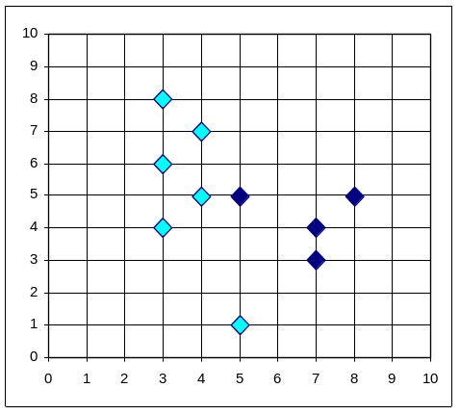
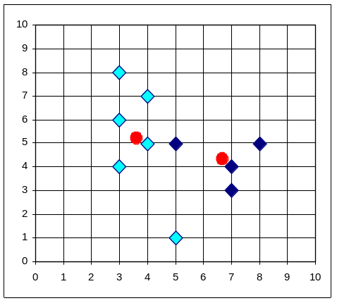


K-Means Clustering Method
Example

Slide 4

How the K-Mean Clustering algorithm works?

Slide 5
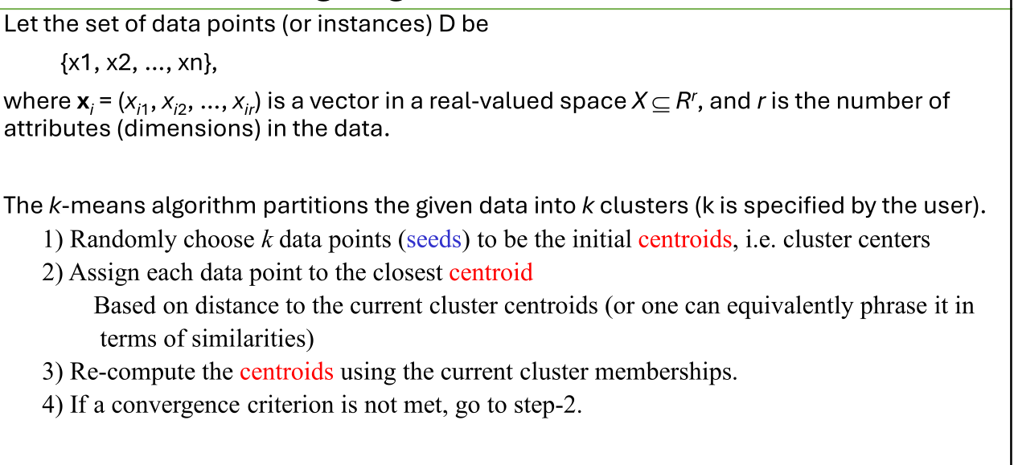
K means algorithm

Slide 6
Stopping/convergence criterion
• no (or minimum) re-assignments of data points to different clusters,
• no (or minimum) change of centroids, or
• minimum decrease in the sum of squared error (SSE)

Slide 7

A Simple example showing the implementation of k-means algorithm
(using K=2)

Slide 8


Step 1:
Initialization: Randomly we choose following two centroids (k=2) for two clusters.
In this case the 2 centroid are: m1=(1.0,1.0) and m2=(5.0,7.0).

Slide 9




Step 2:
Thus, we obtain two clusters containing:
{1,2,3} and {4,5,6,7}.
Their new centroids are:

Slide 10

Step 3:
Now using these centroids we compute the Euclidean distance of each object, as shown in table.
Therefore, the new clusters are:
{1,2} and {3,4,5,6,7}
Next centroids are: m1=(1.25,1.5) and m2 = (3.9,5.1)

Slide 11

Step 4 :
The clusters obtained are:
{1,2} and {3,4,5,6,7}
Therefore, there is no change in the cluster.
Thus, the algorithm comes to a halt here and final result consist of 2 clusters {1,2} and {3,4,5,6,7}.

Slide 12

PLOT

Slide 13
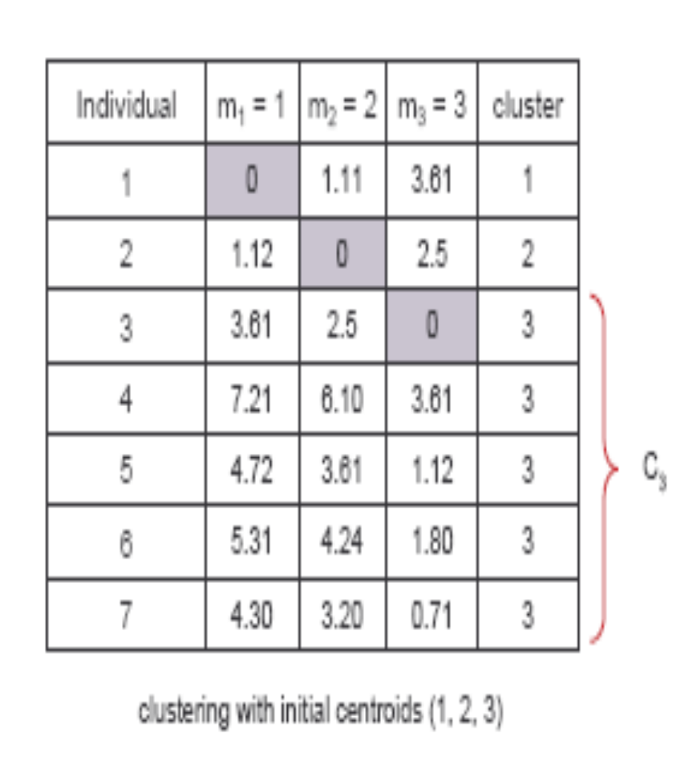
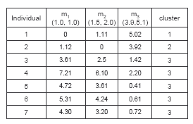
(with K=3)
Step 1
Step 2

Slide 14
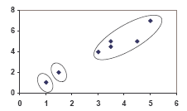
PLOT

Slide 15
Comments on the K-Means Method
Strength
  Relatively efficient
  Often terminates at a local optimum. The global optimum may be found using techniques such as: deterministic annealing and genetic algorithms
Weakness
  Applicable only when mean is defined
  Need to specify k, the number of clusters, in advance
  Unable to handle noisy data and outliers
  Not suitable to discover clusters with non-convex shapes

Slide 16
Real-Life Numerical Example of K-Means Clustering
We have 4 medicines as our training data points object and each medicine has 2 attributes. Each attribute represents coordinate of the object. We have to determine which medicines belong to cluster 1 and which medicines belong to the other cluster.
Object | Attribute1 (X): weight index | Attribute 2 (Y): pH
Medicine A | 1 | 1
Medicine B | 2 | 1
Medicine C | 4 | 3
Medicine D | 5 | 4

Slide 17
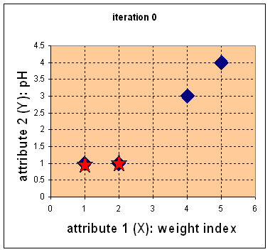
Step 1:
Initial value of centroids : Suppose we use medicine A and medicine B as the first centroids.
Let and c₁ and c₂ denote the coordinate of the centroids, then c₁=(1,1) and c₂=(2,1)

Slide 18
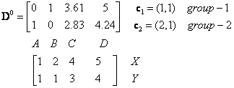
Objects-Centroids distance : we calculate the distance between cluster centroid to each object. Let us use Euclidean distance, then we have distance matrix at iteration 0 is
Each column in the distance matrix symbolizes the object.
The first row of the distance matrix corresponds to the distance of each object to the first centroid and the second row is the distance of each object to the second centroid.
For example, distance from medicine C = (4, 3) to the first centroid is , and its distance to the second centroid is , is etc.

Slide 19
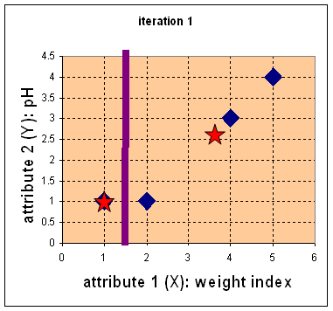

Step 2:
Objects clustering : We assign each object based on the minimum distance.
Medicine A is assigned to group 1, medicine B to group 2, medicine C to group 2 and medicine D to group 2.
The elements of Group matrix below is 1 if and only if the object is assigned to that group.

Slide 20
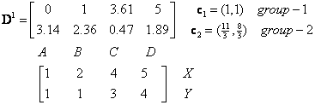
Iteration-1, Objects-Centroids distances : The next step is to compute the distance of all objects to the new centroids.
Similar to step 2, we have distance matrix at iteration 1 is

Slide 21
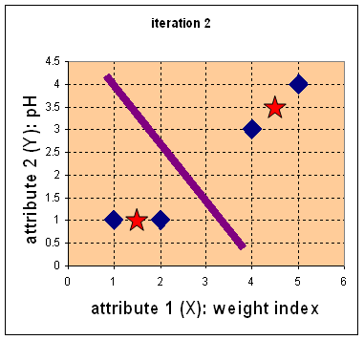



Iteration-1, Objects clustering:Based on the new distance matrix, we move the medicine B to Group 1 while all the other objects remain. The Group matrix is shown below
Iteration 2, determine centroids: Now we repeat step 4 to calculate the new centroids coordinate based on the clustering of previous iteration. Group1 and group 2 both has two members, thus the new centroids are
and

Slide 22
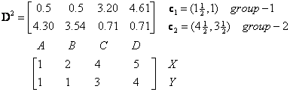
Iteration-2, Objects-Centroids distances : Repeat step 2 again, we have new distance matrix at iteration 2 as

Slide 23

Iteration-2, Objects clustering: Again, we assign each object based on the minimum distance.
We obtain result that . Comparing the grouping of last iteration and this iteration reveals that the objects does not move group anymore.
Thus, the computation of the k-mean clustering has reached its stability and no more iteration is needed..

Slide 24
Thank You

